Slide 1
Test Driven Development
Course “JUnit magic”
Section 6

Slide 2
Agenda
Test First Development
Test Driven Development

Slide 3
TEST FIRST DEVELOPMENT

Slide 4
Test First Development
You write a test before you write just enough production code to fulfill that test.

Slide 5
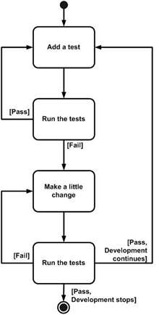
The steps of TFD (1)
First the developer writes a failing automated test case that defines a desired improvement or new function.
1

Slide 6
The steps of TFD (2)
Next you run your tests, to ensure that the new test does in fact fail.
2

Slide 7
The steps of TFD (3)
You then update your functional code to make it pass the new tests.
3

Slide 8
The steps of TFD (4)
The fourth step is to run your tests again.
  If they fail you need to update your functional code and retest.
  Once the tests pass the next step is to start over.
4

Slide 9
TEST DRIVEN DEVELOPMENT

Slide 10
TDD
TDD = TFD + Refactoring

Slide 11
Refactoring
Code refactoring is "disciplined technique for restructuring an existing body of code, altering its internal structure without changing its external behavior", undertaken in order to improve some of the nonfunctional attributes of the software.

Slide 12
The Goal of TDD
The goal of TDD is to write clean code that works.
  Ron Jeffries,
  creator of the Extreme Programming (XP)
TDD encourages simple designs and inspires confidence.
Kent Back,
creator of the Extreme Programming (XP)

Slide 13
Two simple rules for TDD
First, you should write new business code only when an automated test has failed.
Second, you should eliminate any duplication that you find.
Kent Beck,
creator of the Extreme Programming (XP)

Slide 14
Kent Beck explanation of TDD rules
You develop organically, with the running code providing feedback between decisions.
You write your own tests because you can't wait 20 times per day for someone else to write them for you.

Slide 15
Kent Beck explanation of TDD rules
Your development environment must provide rapid response to small changes.
Your designs must consist of highly cohesive, loosely coupled components to make testing easier.

Slide 16
Two levels of TDD
Acceptance TDD (ATDD)
Developer TDD (TDD)

Slide 17
Acceptance TDD
With ATDD you write a single acceptance test, or behavioral specification depending on your preferred terminology, and then just enough production functionality/code to fulfill that test.

Slide 18
Acceptance TDD goal
The goal of ATDD is to specify detailed, executable requirements for your solution on a just in time basis. ATDD is also called Behavior Driven Development (BDD).

Slide 19
Developer TDD
With Developer TDD you write a single developer test, sometimes inaccurately referred to as a unit test, and then just enough production code to fulfill that test.

Slide 20
Developer TDD goal
The goal of developer TDD is to specify a detailed, executable design for your solution on a JIT basis. Developer TDD is often simply called TDD.

Slide 21
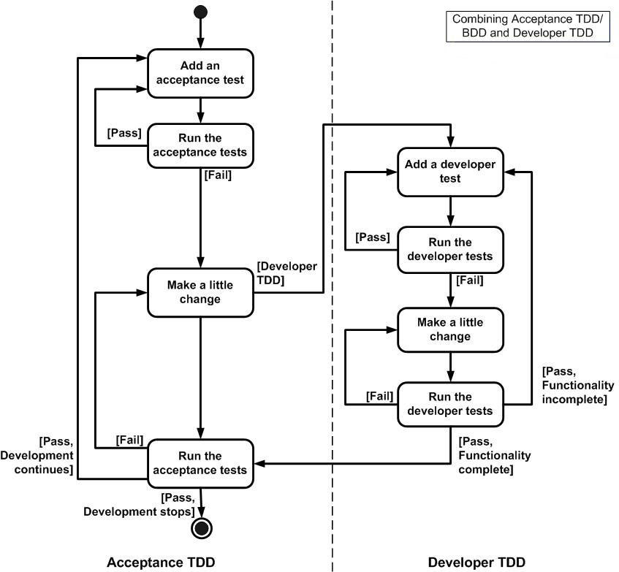
How acceptance TDD and developer TDD work together

Slide 22
A good unit test means
Run fast (they have short setups, run times, and break downs).
Run in isolation (you should be able to reorder them).
Use data that makes them easy to read and to understand.
Use real data (e.g. copies of production data) when they need to.

Slide 23
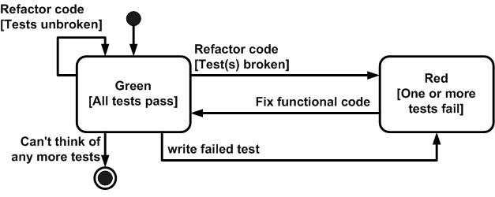
Testing via the xUnit Framework

Slide 24

Any Questions?

Slide 25
References
xUnit Test Patterns: Refactoring Test Code: http://martinfowler.com/books.html
http://www.agiledata.org/essays/tdd.html

